Slide 1

POWER BI PROJECT
Bank Loan Risk & Default Intelligence
Summer Training — Power BI | Chandigarh Engineering College
Presented by
Course
Guided by
Date
Bhumika | 2420696
B.Tech – AI & DS
Dr. Ashima
Ms. Mandeep Kaur
03 July 2026

Slide 2
Agenda
01
Problem Statement & Objective
04
Dashboard Walkthrough
02
Dataset Overview
05
Key Insights & Findings
03
Data Model — Star Schema
06
Conclusion
04
9
05
2 / 14

Slide 3
01 Problem Statement
What problem does this dashboard solve?
3 / 14

Slide 4
Problem Statement & Objectives
The Problem
Target User
The credit risk team needs to monitor default rates by loan grade, income band, and purpose to flag high-risk segments. Managing this via raw data is slow and manual, delaying critical tracking. Without a clear view, managers cannot easily spot dangerous trends—like low-income borrowers taking out high-interest business loans. This lack of visibility delays policy updates, risk threshold adjustments, and pricing modifications needed to minimize bank losses.
Credit Risk Managers and Portfolio Analysts who need a live, interactive view of default distributions without manually compiling messy Excel sheets each week.
Project Objectives
Sourced a raw credit dataset from Kaggle and utilized Python to audit and verify that it was completely free of duplicates, null values, and blank spaces.
Converted technical database flags (0 and 1) into human-readable business categories (such as changing not.fully.paid into "Paid Back" or "Defaulted").
Reconstructed compressed logarithmic annual income figures back into true dollar values using mathematical formulas (=EXP) to allow for accurate consumer analysis.
Created core DAX metrics (Total Loans, Defaulted Loans, Default Rate) and designed a multi-page interactive dashboard with a dedicated Borrower Profile drill-through page to help the risk team instantly flag high-exposure loan segments.
Built custom business rules to categorize borrowers into distinct Income Bands and Loan Grades based on their raw FICO credit scores.
4 / 14

Slide 5
02 Dataset Overview
Source, structure, and key fields
5 / 14

Slide 6
Dataset Overview
Kaggle
CSV
9,579
14
Source
File Type
Rows
Columns
Data Quality Steps (Power Query)
Key Columns Used
Verified data integrity using Python to ensure zero duplicates or nulls.
Column | Role in Dashboard
default_status | Primary target variable tracking "Defaulted" vs "Paid Back"
loan_grade | Risk tiers segmented using FICO score thresholds
income_band | Financial categories derived by reversing log income data
loan_purpose | Categorical breakdown used to track risk profiles
dti_ratio | Performance metric to measure borrower debt burden
Converted binary flags (0 and 1) into "Paid Back" and "Defaulted".
Reconstructed true borrower salaries using the Excel =EXP() formula.
Renamed column names for clarity.
Added annual_income (in $) by reversing log data, then utilized nested formulas to construct income_band brackets and FICO-based loan_grade tiers for deeper risk segmentation.
Grouped financial tiers using an engineered income_band formula.
Created a loan_grade classification scheme based on FICO scores.
6 / 14

Slide 7
03 Data Model
Star schema design & relationships
7 / 14

Slide 8

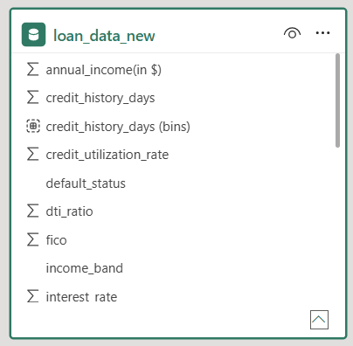
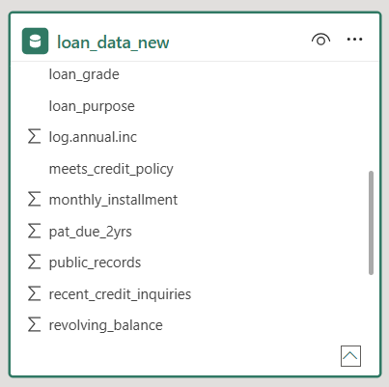
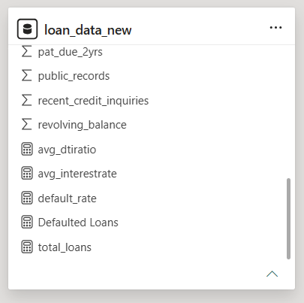
 | loan_data_new — Contains the core numeric operational metrics and continuous features, including interest_rate, monthly_installment, dti_ratio, fico, and the primary target variables used for custom DAX measures (Total Loans, Defaulted Loans, and Default Risk %).
 | loan_purpose Dim — Extracted lookup table containing unique loan purposes (e.g., small_business, credit_card, debt_consolidation) to drive category-specific default distributions.
 | loan_grade Dim — Lookup table containing structural credit rating tiers, filtering borrower performance across distinct underwriting qualities.
Schema Type
Star Schema
Fact Table
Dimension Table 1
Dimension Table 2
Dimension Table 3
income_band Dim — Segments borrowers into distinct economic demographics
(income_band: Low, Middle, or High Income) to drive consumer affluence charts.
All independent dimension lookup tables are mapped directly to the central
loan_data_new fact table using a One-to-Many (1: ∞) relationship with a
Single cross-filter direction moving from the dimension table to the fact table.
Relationships

Slide 9
04 Dashboard Walkthrough
Pages, visuals, and interactivity
11 / 14

Slide 10
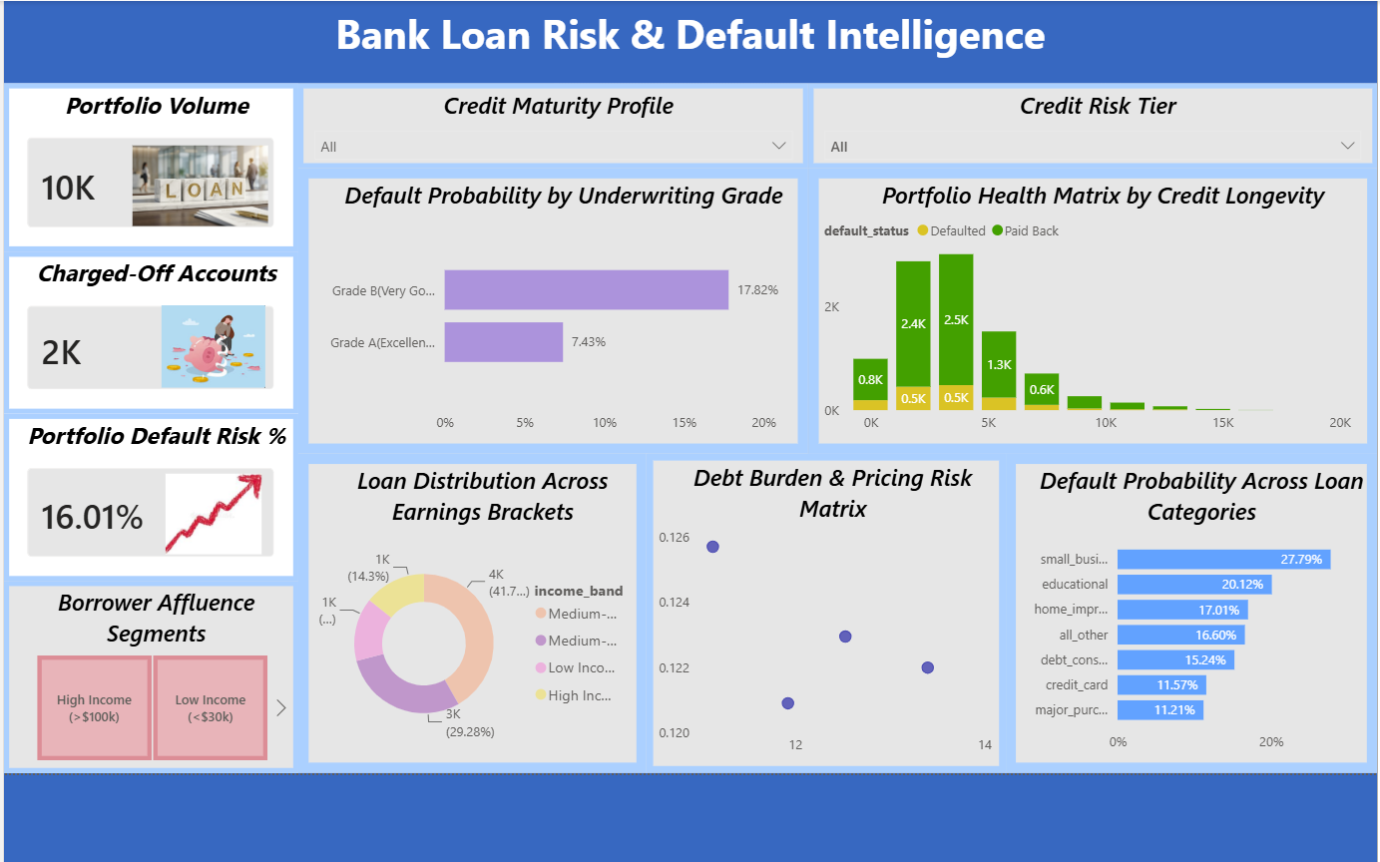
Dashboard — Page 1: Overview
Visuals on this page
3 KPI Cards — Portfolio Volume, Charged-Off Accounts, Portfolio Default Risk %
3 Slicers — Borrower Affluence Segments, Credit Maturity Profile, Credit Risk Tier
2 Clustered Bar Chart — Default Probability by Underwriting Grade, Default Probability across Loan Categories
Scatter Plot — Debt Burden & Pricing Risk Matrix
[ Screenshot — Overview Page ]
Stacked Column Chart — Portfolio Health Matrix by Credit Longevity
Donut Chart — Loan Distributions Across Earnings Brackets
Key Insight
While the bank's overall default rate is 16.01%, high-risk areas like small business loans spike to 27.79%. This instantly flags the exact high-exposure segments where management needs to tighten credit approval policies to minimize losses.
12 / 14

Slide 11
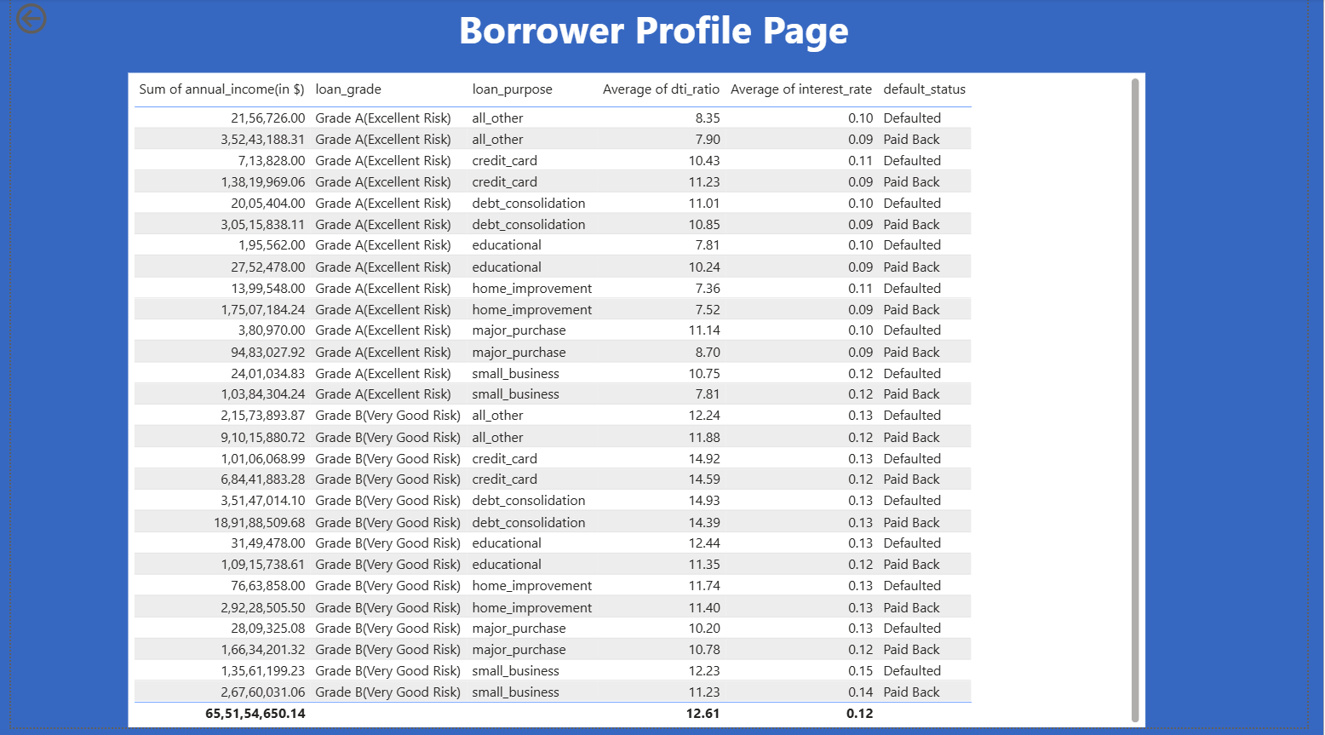
Page 2: Borrower Profile Page
Visuals on this page
Detailed Table Visual: A granular, row-level reporting grid containing calculated metrics: Sum of annual_income, loan_grade, loan_purpose, Average of dti_ratio, Average of interest_rate, and default_status.
Key Insight
This page acts as an operational ledger, breaking down macro metrics into granular financial records sorted by underwriting grade and intent. It enables risk auditors to investigate specific, high-exposure rows—such as Grade B small business loans with higher average DTI ratios and interest rates—to track exactly which profile segments drive defaults.

Slide 12
05 Key Findings & Insights
The bank maintains an overall portfolio volume of 10K loans with a baseline portfolio default risk of 16.01%.
Credit cards (11.57%) and major purchases (11.21%) represent the safest loan purposes with the lowest default probabilities in the portfolio.
01
04
Small business loans pose the greatest credit threat, showing an exceptionally high default probability of 27.79%.
The donut chart highlights that middle-income segments make up the clear majority of loan distributions, while high-income and low-income categories remain outlier segments.
02
05
Default probability drops significantly by grade; Grade B accounts have a 17.82% default probability, while safer Grade A accounts drop sharply to 7.43%.
03
13 / 14

Slide 13
06 Conclusion & Thank You
Successfully built an end-to-end Power BI business intelligence solution from raw Kaggle data to a published interactive dashboard.
Identified that while the baseline portfolio risk is 16.01%, small business loans represent the highest exposure area with a 27.79% default rate.
Engineered high-performance DAX measures for core credit KPIs and used Excel mathematical functions (=EXP) to successfully reverse and normalize logarithmic borrower income data.
Future Scope: Integrate advanced machine learning models (like logistic regression) directly into the pipeline to predict real-time default probabilities for new loan applicants.
Questions & Feedback Welcome
14 / 14

